Slide 1
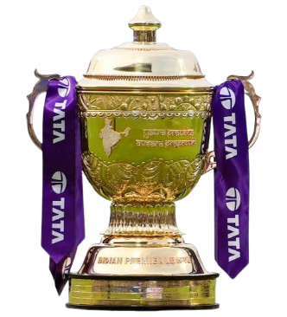
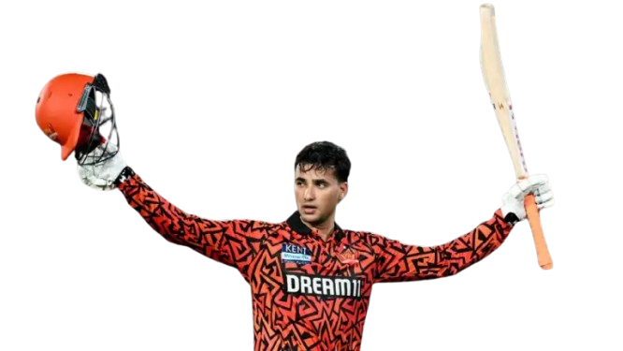

IPL - Team Performance Analyzer
Python Learning Project
Technologies Used: Python | Pandas | NumPy | Matplotlib
Presented by:
SivaKumar .R

Slide 2

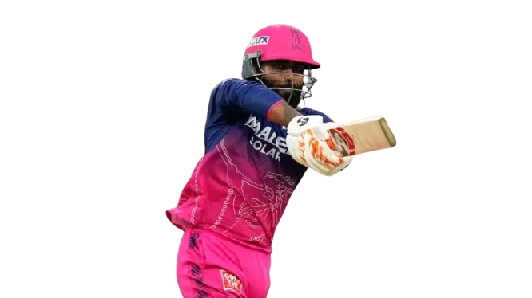
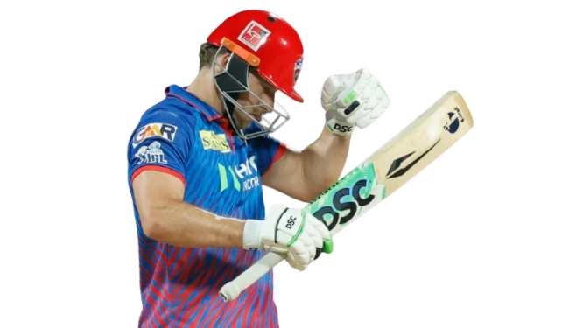
Introduction
IPL generates a large amount of team performance data.
Comparing all teams manually can be difficult.
This project analyzes IPL 2026 team statistics using Python.
The data is stored in a CSV file and processed using Python.
The project provides both Statistical analysis and Graphical analysis.
Users can select different options through a menu-driven program.

Slide 3
Project Objectives
Analyze the performance of IPL 2026 teams.
Find teams with the highest and lowest performance values.
Calculate useful team statistics.
Use Pandas for handling CSV data.
Use NumPy for numerical calculations.
Use Matplotlib for graphical visualization.
Provide an easy-to-use menu-driven interface.

Slide 4
Dataset Used
The project uses a single CSV file:
ipl_2026_teams.csv
Important columns:
Team
Matches
Total Runs
Highest Run Player
Highest Wicket Player
Total Wickets
Total Fours
Total Sixes
Average Team Score
Wins
Win Percentage
Highest Team Score
Lowest Team Score
Centuries
Fifties
Five Wicket Hauls
Hat Tricks

Slide 5
Technologies Used
Technology | Purpose
Python | Main programming language
Pandas | Reading and analyzing CSV data
NumPy | Numerical calculations
Matplotlib | Creating graphs
CSV | Storing team statistics
Python concepts used:
Variables
Conditions
for loop
while loop
Functions
Lists
Modules
User input
Menu-driven programming

Slide 6
Project Workflow
How the Project Works
IPL 2026 CSV Dataset
Read using Pandas
Store data in "data"
User selects an option
Python processes the data
Statistical Analysis
Graphical Analysis
Results
Matplotlib

Slide 7
Statistical Analysis
Features of the Project
The program can find:
  Team with Most Runs
  Team with Most Sixes
  Team with Most Fours
  Team with Most Wickets
  Team with Highest Average Score
  Team with Most Victories
  Team with Highest Win Percentage
  Highest Team Score
  Lowest Team Score
  Top Performer of Each Team
  Average Total Runs of All Teams
  The program also provides a complete team statistics display.

Slide 8
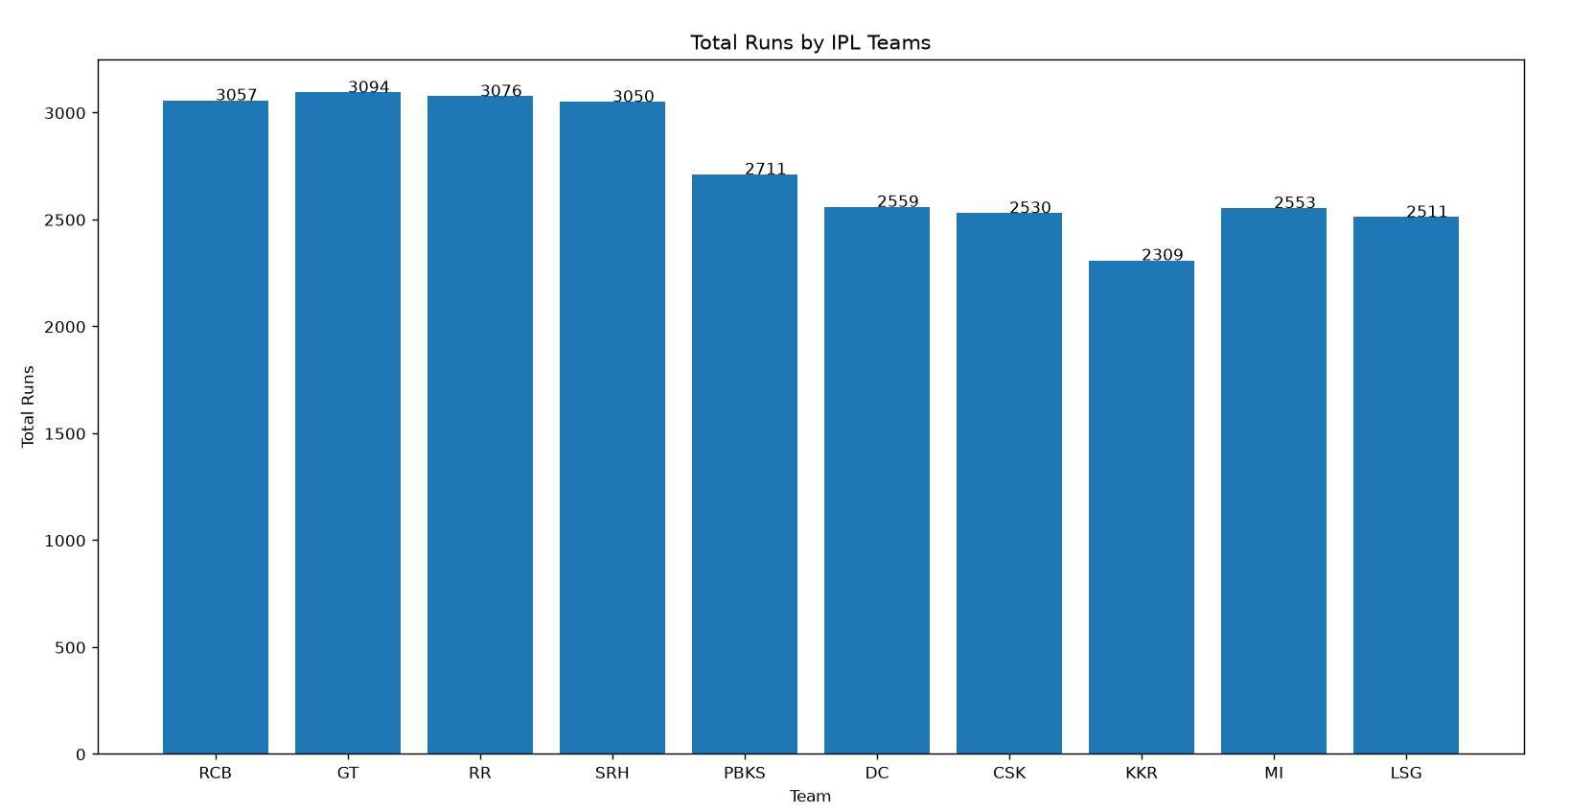
Graphical Analysis
Data Visualization
The project provides 6 different graphs:
  Total Runs by Team — Bar Chart
  Total Sixes by Team — Horizontal Bar Chart
  Total Wickets by Team — Pie Chart
  Wins vs Losses — Stacked Bar Chart
  Win Percentage — Line Chart
  Highest vs Lowest Team Score — Grouped Bar Chart

Slide 9
Conclusion
The project successfully analyzes IPL 2026 team performance using Python.
Pandas makes CSV data handling easier.
NumPy is used for numerical analysis.
Matplotlib helps visualize team performance.
The menu-driven approach allows users to interact with the project easily.
The project helped apply Python concepts learned during the training.
Future Scope:
Interactive dashboards
Database integration
Machine Learning-based performance prediction

Slide 10

THANK YOU!!

